Slide 1
Chews Three Act
Created by Jen Barker

Slide 2
Act One

Slide 4
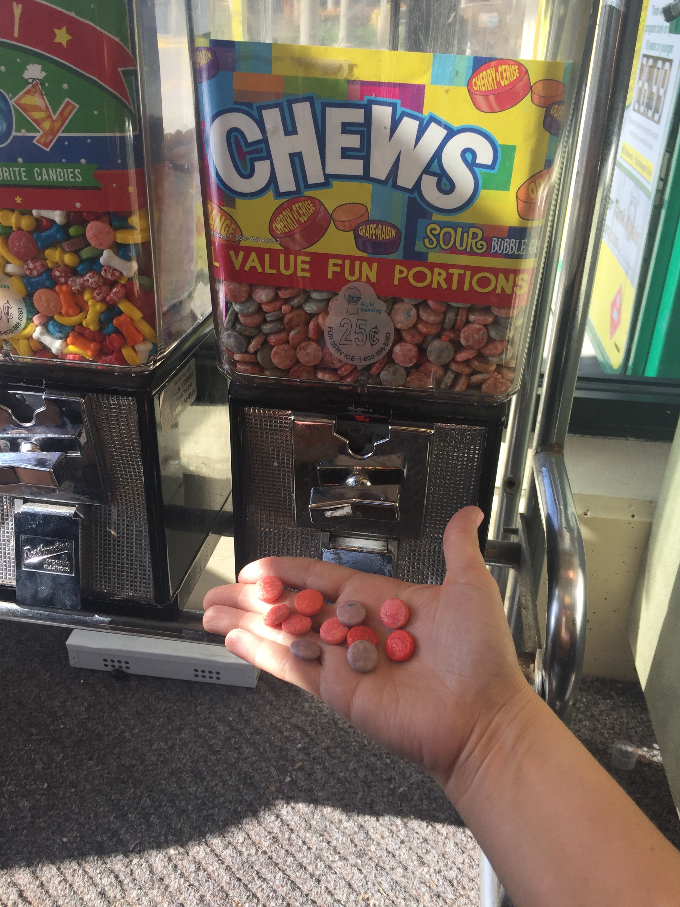
Act Two
11 candies came out.
5 candies were
given away!

Slide 5
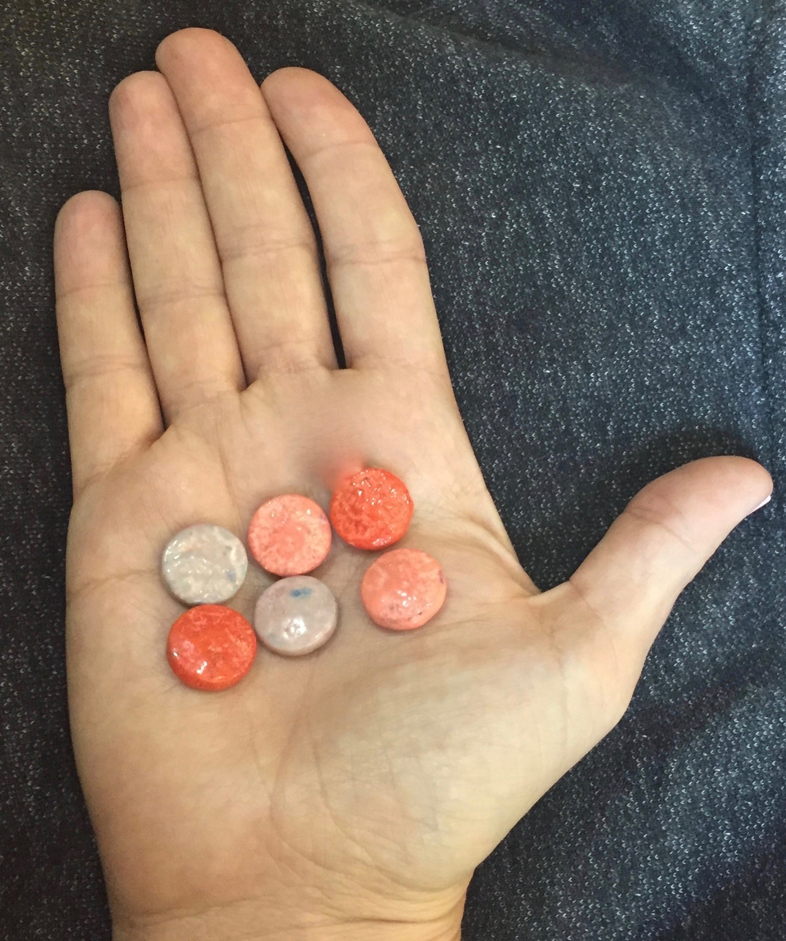
Act Three
I had this many left.

