Slide 1
Halloween Candy
to 20
Three Act Task

Slide 2
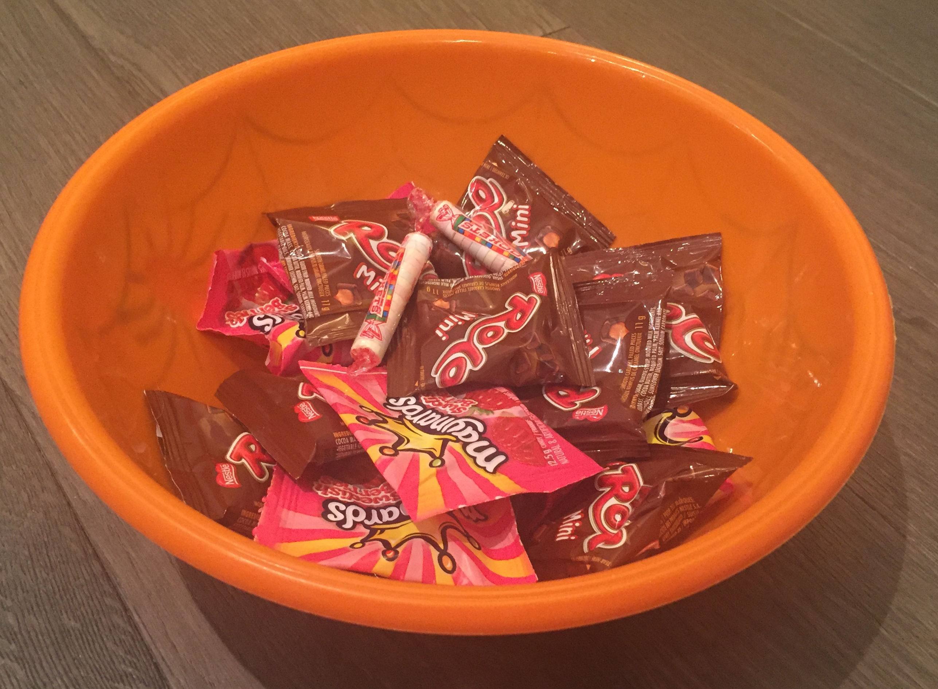
Act One

Slide 3
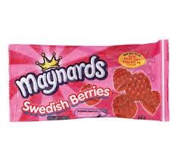
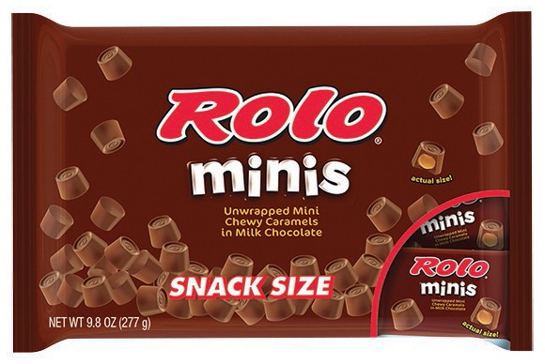
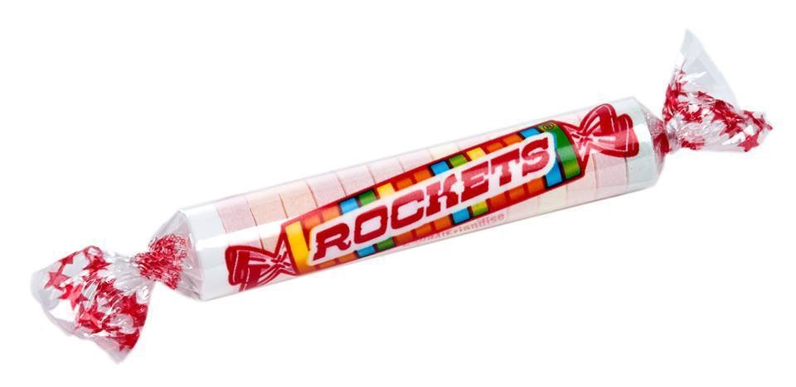
Act Two
9
8
2

Slide 4
Act Three

